Slide 1
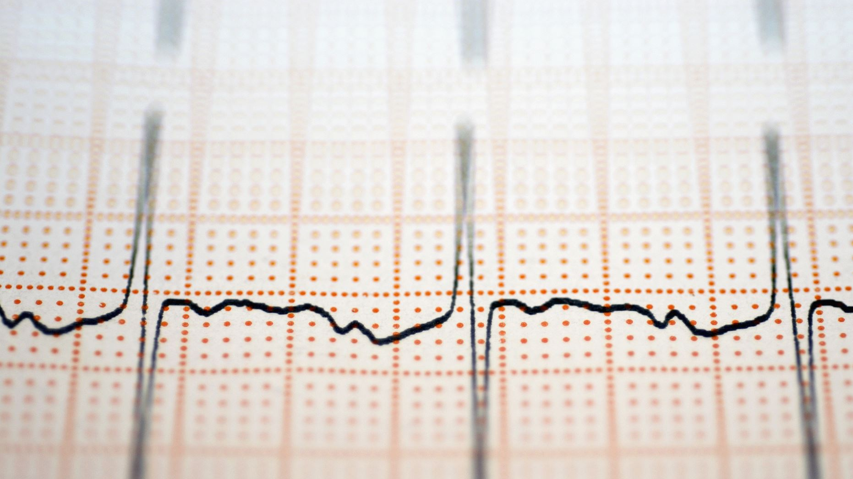
Image Compression using Singular Value Decomposition (SVD)
DASC-5308 – Numerical Methods
Prathyusha Pentam ( A04342934)
Texas A and M university corpus Christi
Goal of the Project
Use SVD and low-rank approximation to compress
images while keeping them visually acceptable
.

Slide 2

Project Overview
Goal: Use Singular Value Decomposition (SVD) and low-rank approximation to compress images while keeping them visually acceptable.
Dataset: Landscape Pictures dataset from Kaggle – natural outdoor scenes like mountains, sea, desert, beaches, islands, and nature views.
Image Representation: Convert each image to 256 × 256 grayscale, so it becomes a matrix of pixel values.
Method:
Apply SVD to each image matrix.
Reconstruct images using different ranks k (e.g., 5, 20, 50, 100).
Evaluation:
Compute relative reconstruction error between original and compressed images.
Calculate compression ratio based on number of stored values.
Visually compare original vs rank-k images.
Main Idea: Show the trade-off between image quality and compression using a core numerical linear algebra tool (SVD).

Slide 3
Motivation:
Why Image Compression?
Modern phones, laptops and websites store thousands of photos, so all these image files quickly add up and use a lot of storage space on our devices and servers.
High-resolution photos contain a lot more pixels, which means more data per image, so big image collections or datasets quickly become very large and heavy to store and process.
When an image file is very large, it takes longer to upload or download and uses more of your internet data, because there is much more information that has to be transferred.
In many photos, large areas like sky, sea, or walls have very similar pixels, so there is a lot of repeated information that we don’t need to store exactly, which makes it possible to compress the image.
The main idea of image compression is to describe the same picture with fewer numbers so it still looks almost the same to our eyes, but uses much less storage space and needs less data to send over the internet.
Instead of using normal image formats like JPEG or PNG, this project uses a mathematical method called Singular Value Decomposition (SVD), which treats the image as a matrix and compresses it by keeping only the most important information, so we can understand the math behind how compression works.

Slide 4
Problem Statement
Objectives
Digital images, especially large and high-resolution ones, take a lot of storage space and are expensive to store and transmit.
Many images contain redundant pixel information, so they don’t actually need all their original data to look good to the human eye.
In this project, we want to see how much we can compress an image by using a mathematical method called Singular Value Decomposition (SVD), while still it keeping the image visually acceptable.
Represent images as matrices
Convert each landscape image to 256 × 256 grayscale and treat image as a matrix of pixel values.
Apply SVD and low-rank approximation
Factor each image matrix using Singular Value Decomposition (SVD).
Reconstruct images using only the top k singular values
Quantitatively evaluate compression
Compute the relative reconstruction error to measure how much information is lost.
Calculate the compression ratio by comparing numbers stored in the original image vs. the rank-k SVD
Visually compare reconstructions
Show original vs rank-k images side by side.
Observe how image quality changes as k increases.
Analyze the trade-off
Study the balance between image quality and compression.
Identify k values that give a good compromise: high compression but still good visual quality.

Slide 5
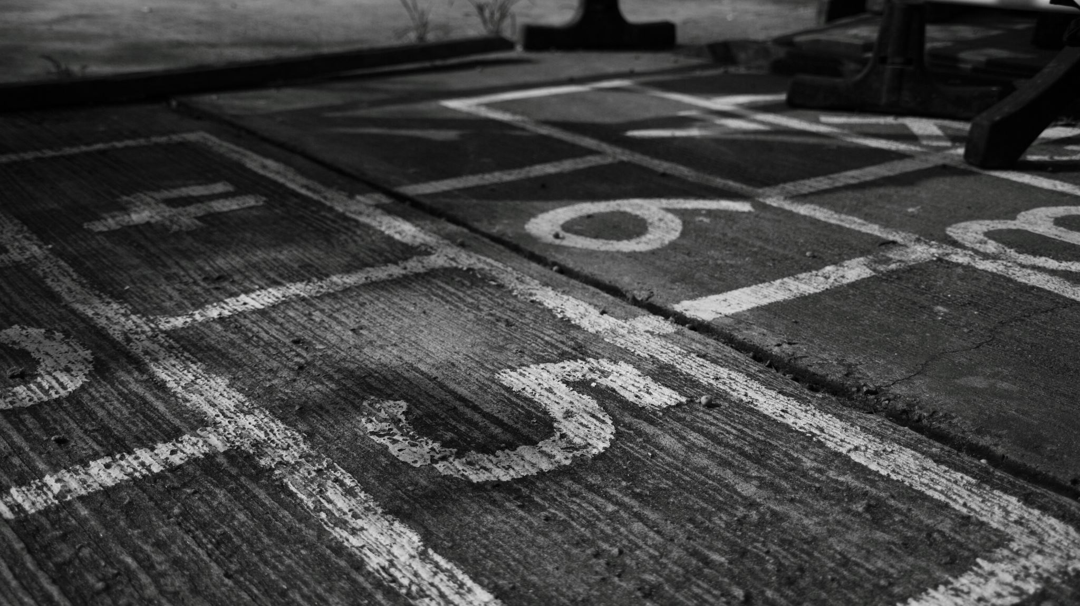

SVD and Low-Rank Approximation
This project is based on the Singular Value Decomposition (SVD) and low-rank approximation topics from our Numerical Methods / Linear Algebra part of the course.
In class, we learned that:
  Any matrix $A$can be written as $A=UΣV^{T}$.
  Keeping only the largest singular values gives the best rank-k approximation of $A$in the least-squares sense.
In this project:
  Each grayscale image is treated as a matrix.
  We use low-rank SVD approximations to compress these matrices.
This directly connects the theory of SVD and low-rank approximation to a practical application: image compression on a real Kaggle dataset.

Slide 6
Dataset Overview
The dataset used is “Landscape Pictures” from Kaggle.
It contains about 4319 landscape images, with a total size of roughly 650 MB.
Images show natural outdoor scenes such as mountains, sea, beaches, islands, deserts, and general landscapes.
The original Flickr-based dataset is grouped into 7 landscape categories:
The pictures are provided as color JPG files with different original resolutions.
The dataset is commonly used for computer vision tasks like image generation, style transfer, and segmentation, making it suitable for SVD-based image experiments. In this project, the dataset is downloaded as a zip file (e.g., archive (15).zip) from Kaggle and extracted into a local folder for processing.
From all available images, only a small subset (head) is selected for experiments to make computations faster and easier to analyze.
These selected images are later resized to 256 × 256 and converted to grayscale, so they can be treated as matrices for SVD.
Notes:
.

Slide 7
Data Preprocessing: Resize and Grayscale Conversion
Image selection:
Use only a small subset (head) of images from the Landscape Pictures dataset for faster experiments.
Resizing:
Each selected image is resized to a fixed size of 256 × 256 pixels so all images have the same dimensions.
Grayscale conversion:
Convert each color image to grayscale (L mode) to remove color information and work with a single channel.
Matrix representation:
The grayscale image is stored as a 2D matrix of pixel values (intensity from 0 to 255).
Reason for this step:
Having same size, grayscale matrices makes it easy to apply SVD and compare results across different images.

Slide 8



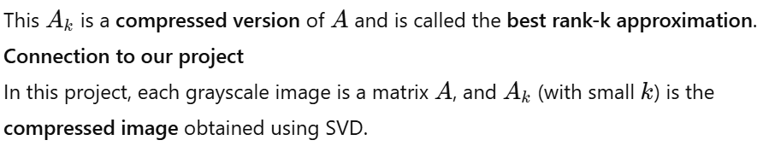
Mathematical Background
SVD factorization
U is a matrix whose columns are special vectors (called left singular vectors) that describe patterns in the rows of the image.
Σ is a diagonal matrix that contains the singular values:
VT (transpose of $V$) contains right singular vectors, which describe patterns in the columns of the image.
SVD as a sum of simple pieces
Low-rank approximation (for compression)

Slide 9

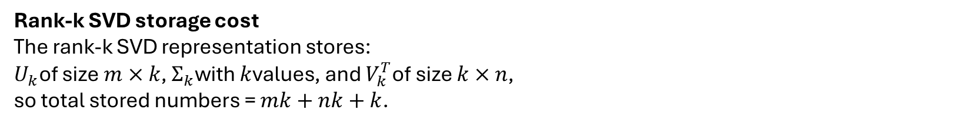
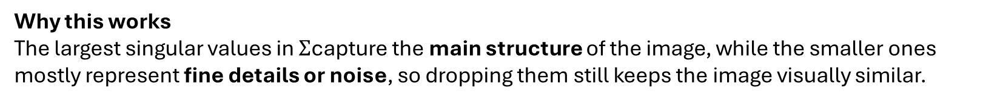
Low-Rank Approximation and Compression Ratio
Low-rank approximation idea
After SVD, an image matrix $A$can be written as $A=UΣV^{T}$.
To compress it, we keep only the top k singular values and vectors, giving a rank-k approximation $A_{k}=U_{k}Σ_{k}V_{k}^{T}$
Why this works
The largest singular values in $Σ$capture the main structure of the image, while the smaller ones mostly represent fine details or noise, so dropping them still keeps the image visually similar.
Original storage cost
The original grayscale image matrix $A$of size $m×n$stores $m⋅n$pixel values.
Rank-k SVD storage cost
The rank-k SVD representation stores:
$U_{k}$of size $m×k$, $Σ_{k}$with $k$values, and $V_{k}^{T}$of size $k×n$,
so total stored numbers = $mk+nk+k$.
Compression ratio formula
Trade-off in our project
For different k values (e.g., $k=5,20,50,100$), we compare relative error and compression ratio, showing that small k gives high compression but more quality loss, while large k gives better quality but less compression.

Slide 10

Implementation Workflow
1. Load dataset
Download the Landscape Pictures (Kaggle)
2. Select and preprocess images
Choose a small subset (head) of images for faster experiments.
For each image: resize to 256 × 256 and convert to grayscale, so it becomes a 2D matrix AAA.
3. Apply SVD to each image matrix
Compute the singular value decomposition:
Use this to build rank–k approximations for different k values (5, 20, 50, 100, etc.).
4. Reconstruct and evaluate
Reconstruct compressed images and clip them to valid pixel range.
Compute relative reconstruction error and compression ratio for each k.
5. Analyze and visualize results
Show original vs rank–k images side by side.
Plot error vs k and compression ratio vs k.
Optionally, repeat over multiple images and average the results.

Slide 11
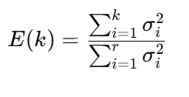
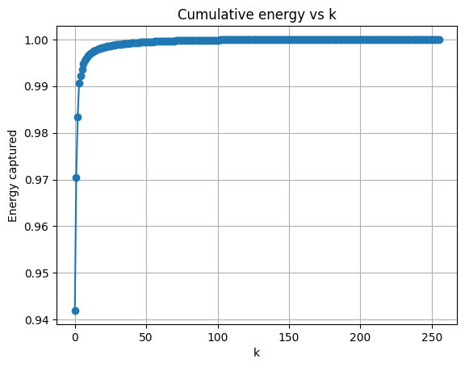
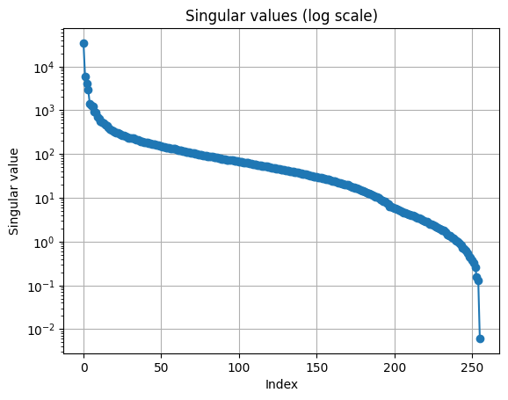
Singular Values & Energy-Based Rank Selection
RESULTS SECTION
After SVD, each image matrix A gives a set of singular values
σ1 ≥ σ2 ≥ σ3 ≥⋯≥ 0
When we plot the singular values, we see they drop quickly at the start and then form a long tail, meaning a few large singular values capture most of the information.
To measure how much information the top k values keep, we use cumulative energy:
The energy curve E(k) usually rises to near 1 (100%) very fast, showing that a small k already captures most of the image energy.
We can choose k based on a target energy level (e.g., 90%, 95%, 99%), so we keep enough singular values to preserve important information while still getting good compression.

Slide 12

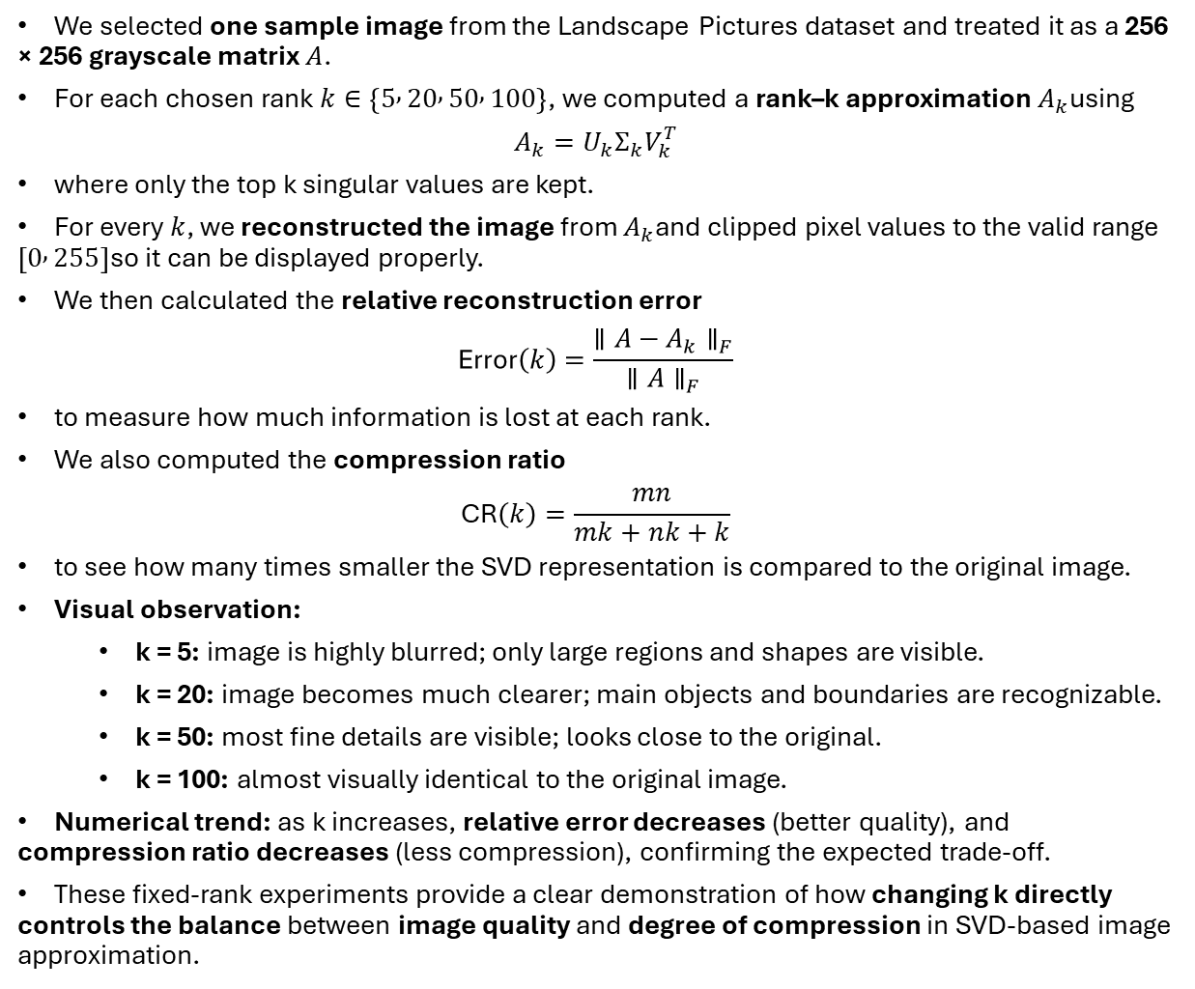
We selected one sample image from the Landscape Pictures dataset and treated it as a 256 × 256 grayscale matrix $A$.
For each chosen rank $k∈\left\{5 , 20 , 50 , 100\right\}$, we computed a rank–k approximation $A_{k}$using
$$A_{k}=U_{k}Σ_{k}V_{k}^{T}$$
where only the top k singular values are kept.
For every $k$, we reconstructed the image from $A_{k}$and clipped pixel values to the valid range $\left[0 , 255\right]$so it can be displayed properly.
We then calculated the relative reconstruction error
$$\text{Error}\left(k\right)=\frac{∥A−A_{k}∥_{F}}{∥A∥_{F}}$$
to measure how much information is lost at each rank.
We also computed the compression ratio
$$\text{CR}\left(k\right)=\frac{mn}{mk+nk+k}$$
to see how many times smaller the SVD representation is compared to the original image.
Visual observation:
  k = 5: image is highly blurred; only large regions and shapes are visible.
  k = 20: image becomes much clearer; main objects and boundaries are recognizable.
  k = 50: most fine details are visible; looks close to the original.
  k = 100: almost visually identical to the original image.
Numerical trend: as k increases, relative error decreases (better quality), and compression ratio decreases (less compression), confirming the expected trade-off.
These fixed-rank experiments provide a clear demonstration of how changing k directly controls the balance between image quality and degree of compression in SVD-based image approximation.
Fixed Rank Experiments

Slide 13
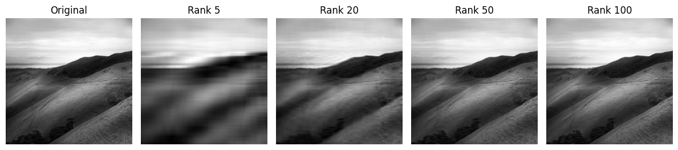
Visual Comparison – Original vs Rank-k Images
We show one original grayscale image and the same image reconstructed with different SVD ranks k (for example, k=5,20,50,100
Each rank–k image is built by keeping only the top k singular values, so it is a compressed version of the original.
Original – full-quality image, no SVD compression.
Rank 5 – very blurry; only big shapes and large regions are visible.
Rank 20 – clearer; main objects and boundaries are visible, acceptable quality.
Rank 50 – good quality; most textures and details appear, close to the original.
Rank 100 – almost the same as the original; differences are hard to see.
This comparison shows the trade-off: small k gives strong compression but lower quality, while large k gives better quality but less compression.

Slide 14
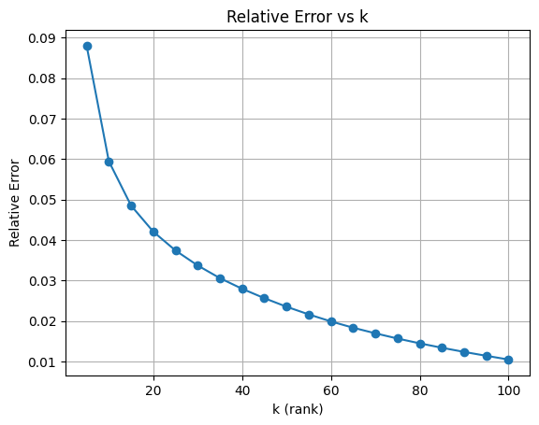

Relative Reconstruction Error vs Rank k
For each rank k, we reconstruct the image as Ak and compute the relative reconstruction error:
We plot Error(k) on the y-axis and k on the x-axis (for k = 5, 10, 15, …, 100).
The curve decreases as k increases, meaning higher rank gives a more accurate reconstruction.
Most of the error drops quickly for small k, and then the curve becomes flatter, showing diminishing returns (small improvement for large k).
This shows that even relatively small k can already give good quality, and very large k is only needed for small extra gains.
Overall, the plot illustrates that image quality improves as we keep more singular values, which matches our visual results.

Slide 15

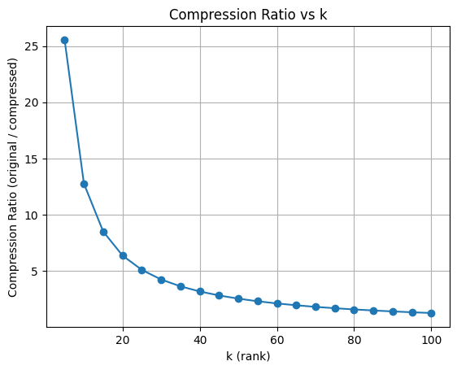
Compression Ratio vs Rank k
We define the compression ratio for rank k as:
where m × n is the image size and mk + nk + k is the number of values in the rank–k SVD.
We plot CR(k) on the y-axis and k on the x-axis for the same k values (5, 10, 15, …, 100).
The curve starts high for small k (strong compression) and drops down toward 1 as k increases.
Small k → very high compression ratio (many times smaller than original), but lower image quality.
Large k → compression ratio close to 1 (almost no compression), but image quality is very close to the original.
This plot clearly shows the inverse relationship: as we increase k to improve quality, we lose compression, highlighting the core trade-off in SVD-based image compression.

Slide 16
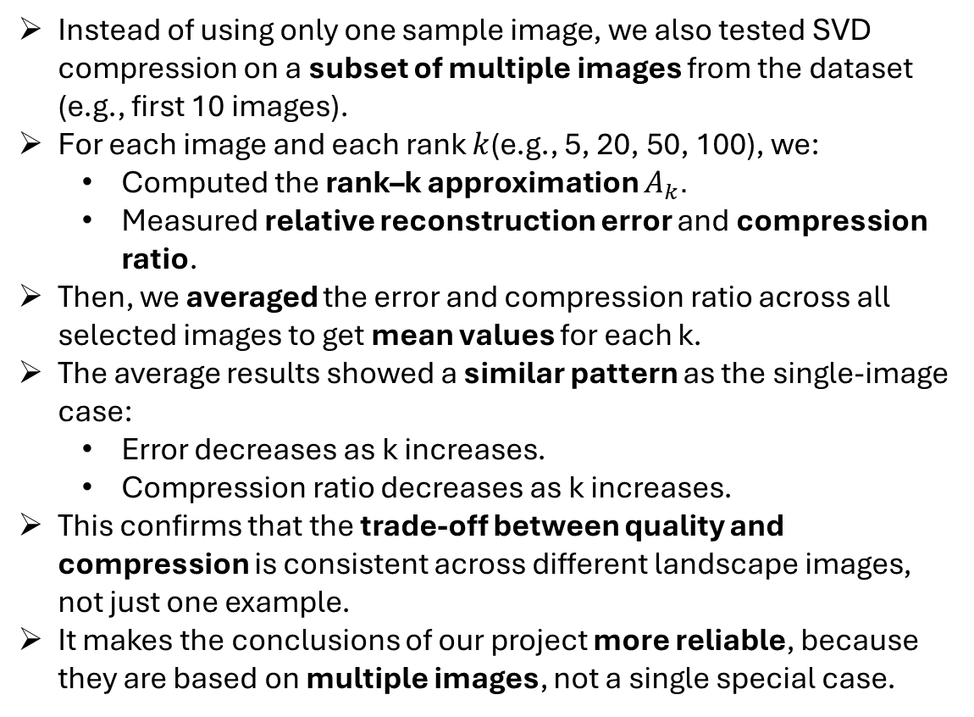
Multi-Image Evaluation: Average Results Over Multiple Images
Instead of using only one sample image, we also tested SVD compression on a subset of multiple images from the dataset (e.g., first 10 images).
For each image and each rank $k$(e.g., 5, 20, 50, 100), we:
  Computed the rank–k approximation $A_{k}$.
  Measured relative reconstruction error and compression ratio.
Then, we averaged the error and compression ratio across all selected images to get mean values for each k.
The average results showed a similar pattern as the single-image case:
  Error decreases as k increases.
  Compression ratio decreases as k increases.
This confirms that the trade-off between quality and compression is consistent across different landscape images, not just one example.
It makes the conclusions of our project more reliable, because they are based on multiple images, not a single special case.

Slide 17
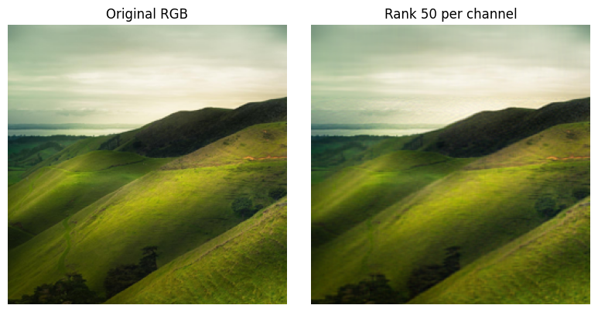
Extension – SVD Compression on Color Images (RGB)
So far, we worked with grayscale images, where each image
is a single 2D matrix.
As an extension, we also tested SVD on color images,
which have three channels: R, G, and B.
Each color image is represented as three matrices:
Red channel (R), Green channel (G), Blue channel (B).
For color compression, we:
Applied SVD separately to each channel matrix (R, G, B).
Reconstructed each channel using rank k.
Combined the three reconstructed channels back into one RGB image.
Visual observations:
With moderate k (e.g., k = 50), the color image still looks very close to the original.
Edges, textures, and colors are mostly preserved, but very fine details may be slightly smoother.
This shows that the same SVD-based low-rank idea can be extended
from grayscale to full color images, by working channel-wise.

Slide 18
Key Insights
Future Work
Landscape images show a strong low-rank structure:
even small ranks (low k) give recognizable images.
There is a clear trade-off:
Small k → high compression, more blur and loss of detail.
Large k → low compression, but quality very close to original.
Quantitative results (error vs k and compression ratio vs k) match the visual results:
Error decreases as k increases.
Compression ratio decreases as k increases.
Averaging over multiple images shows this behavior is consistent across the dataset, not just for one example image.
Compare SVD-based compression more directly with standard formats like JPEG at similar file sizes.
Try different image sizes or other datasets (faces, objects, etc.) to see how low-rank behavior changes.
Explore adaptive selection of k, for example choosing k based on a target error or compression ratio.
Investigate more advanced methods (e.g., truncated SVD algorithms or PCA/CNN-based compression) for larger or higher-resolution images.
Notes:
There are several directions in which this work could be extended. One natural next step is to compare SVD-based compression directly with standard methods like JPEG, using similar file sizes, to evaluate visual quality and performance in a more realistic setting. Another idea is to test the method on other types of datasets, such as faces or object recognition datasets, and on different image resolutions to see how the required rank changes. We could also explore adaptive strategies for choosing $k$, for example selecting the smallest rank that keeps the reconstruction error below a threshold or achieves a target compression ratio. For very large images, it might be necessary to use more efficient techniques like truncated SVD or even explore modern approaches such as deep learning-based compression.

Slide 19
Conclusion
SVD and low-rank approximation provide a simple and effective way to compress images using linear algebra.
Medium ranks (for example k = 20–50 for 256×256 images) often give a good balance between image quality and compression.
The project successfully connects numerical linear algebra theory (SVD) with a practical application (image compression) on a real dataset.

Slide 20
Thank You

